Slide 1

Health Monitoring System for Senior Citizens
Group Members
Javairia Rehman (P19-0020)
Matti Ur Rehman (P19-0048)
Muhammad Mohsin Raza (P19-0072)
Project Supervisor
Dr. Hafeez Ur Rehman

Slide 2


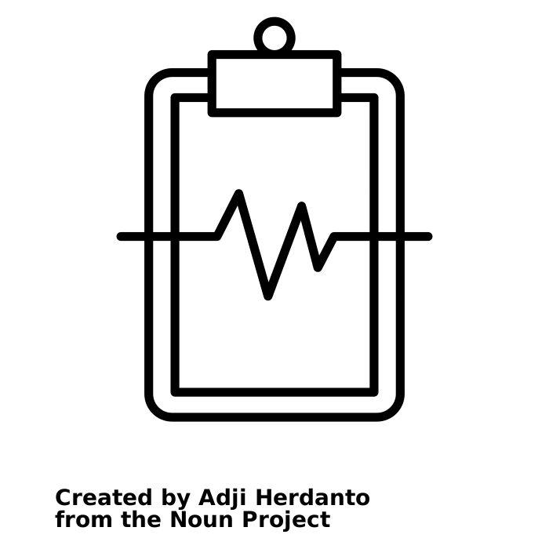
Introduction/ Idea
A World is a Global Village, Right?
Also, Impossible that you are 24/7 Home, Well COVID-19 gone “ALMOST”
Someone at Home, Needs an Attention
‹#›

Slide 3

Problem Statement
An elderly people need to be monitored 24/7. If you are at work space and they are alone.

Slide 4
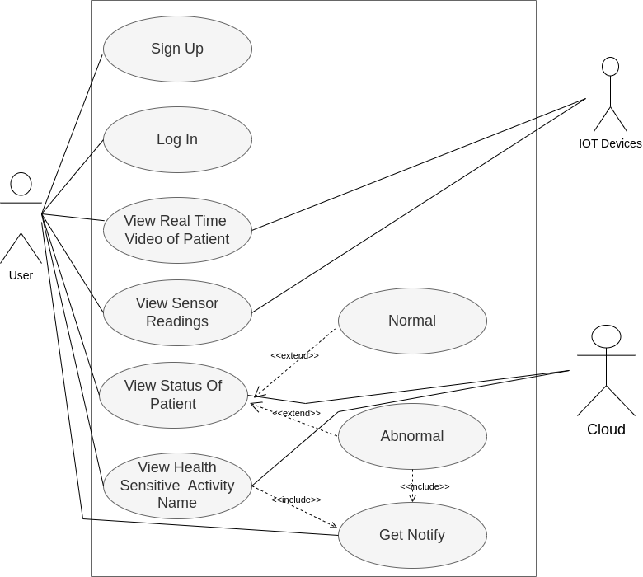
System Analysis and Design
Figure 1: Use Case Diagram

Slide 5
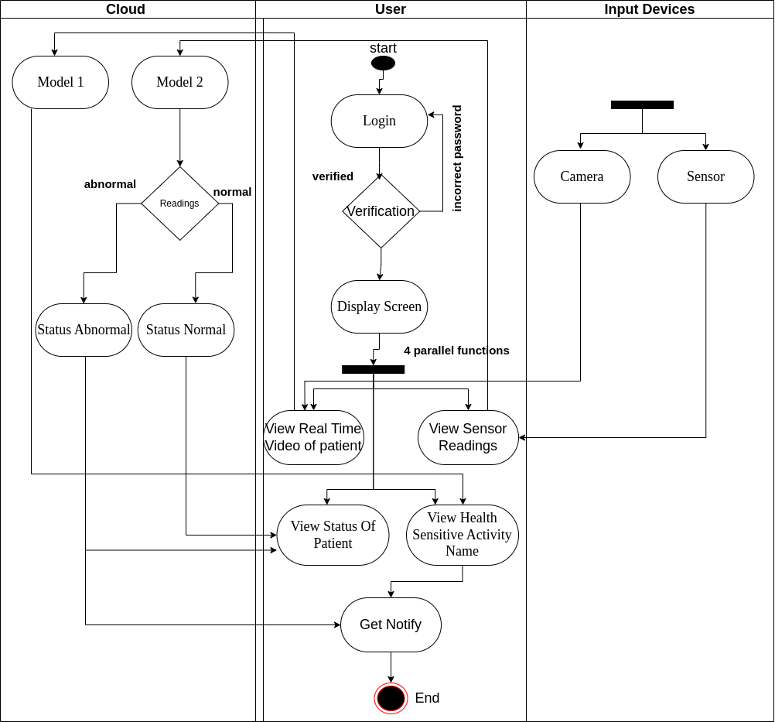
Figure 2: Swimlane Diagram

Slide 6
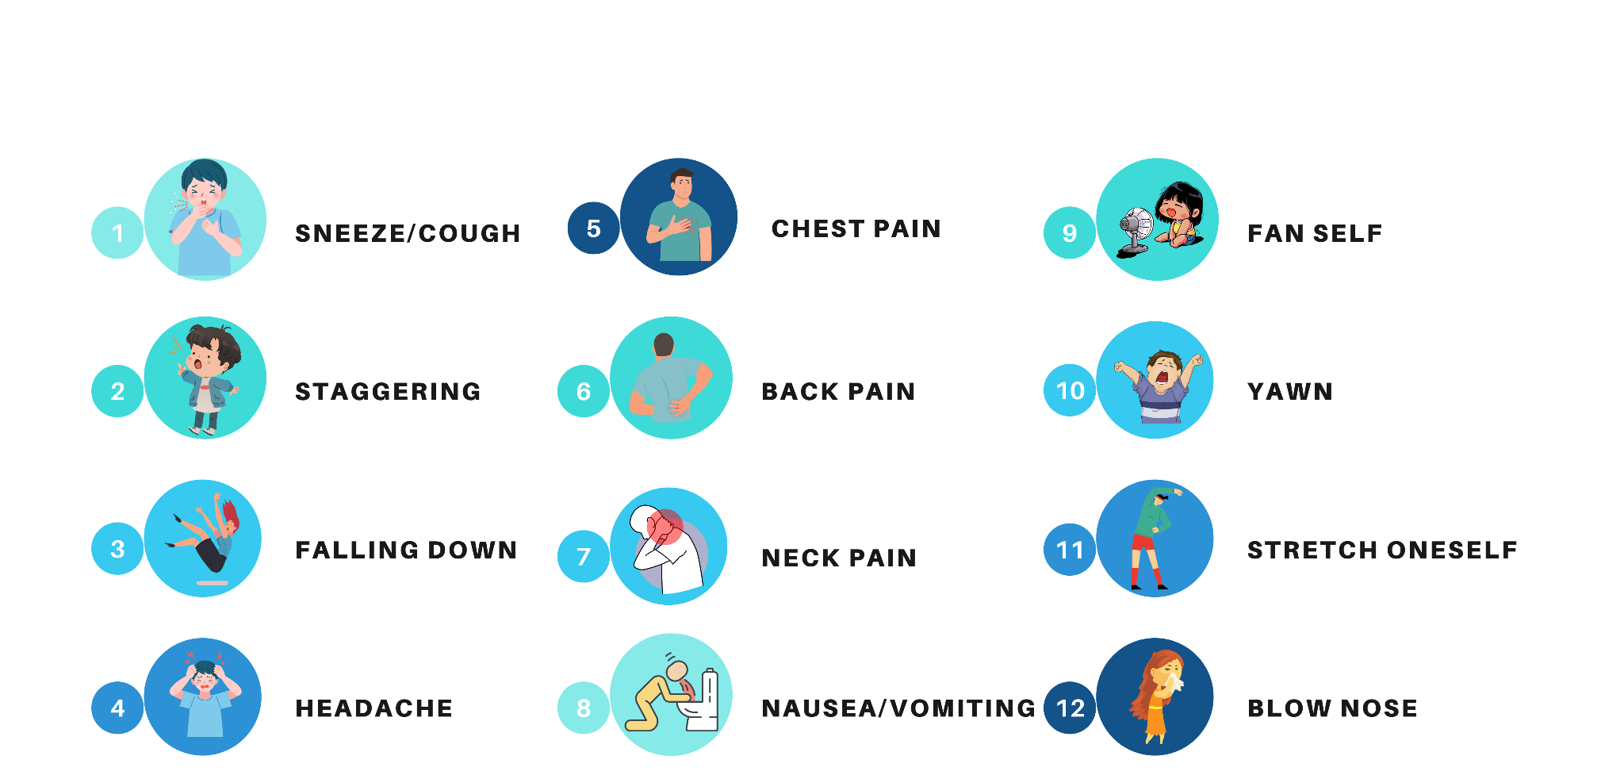
Health Sensitive Activities

Slide 7
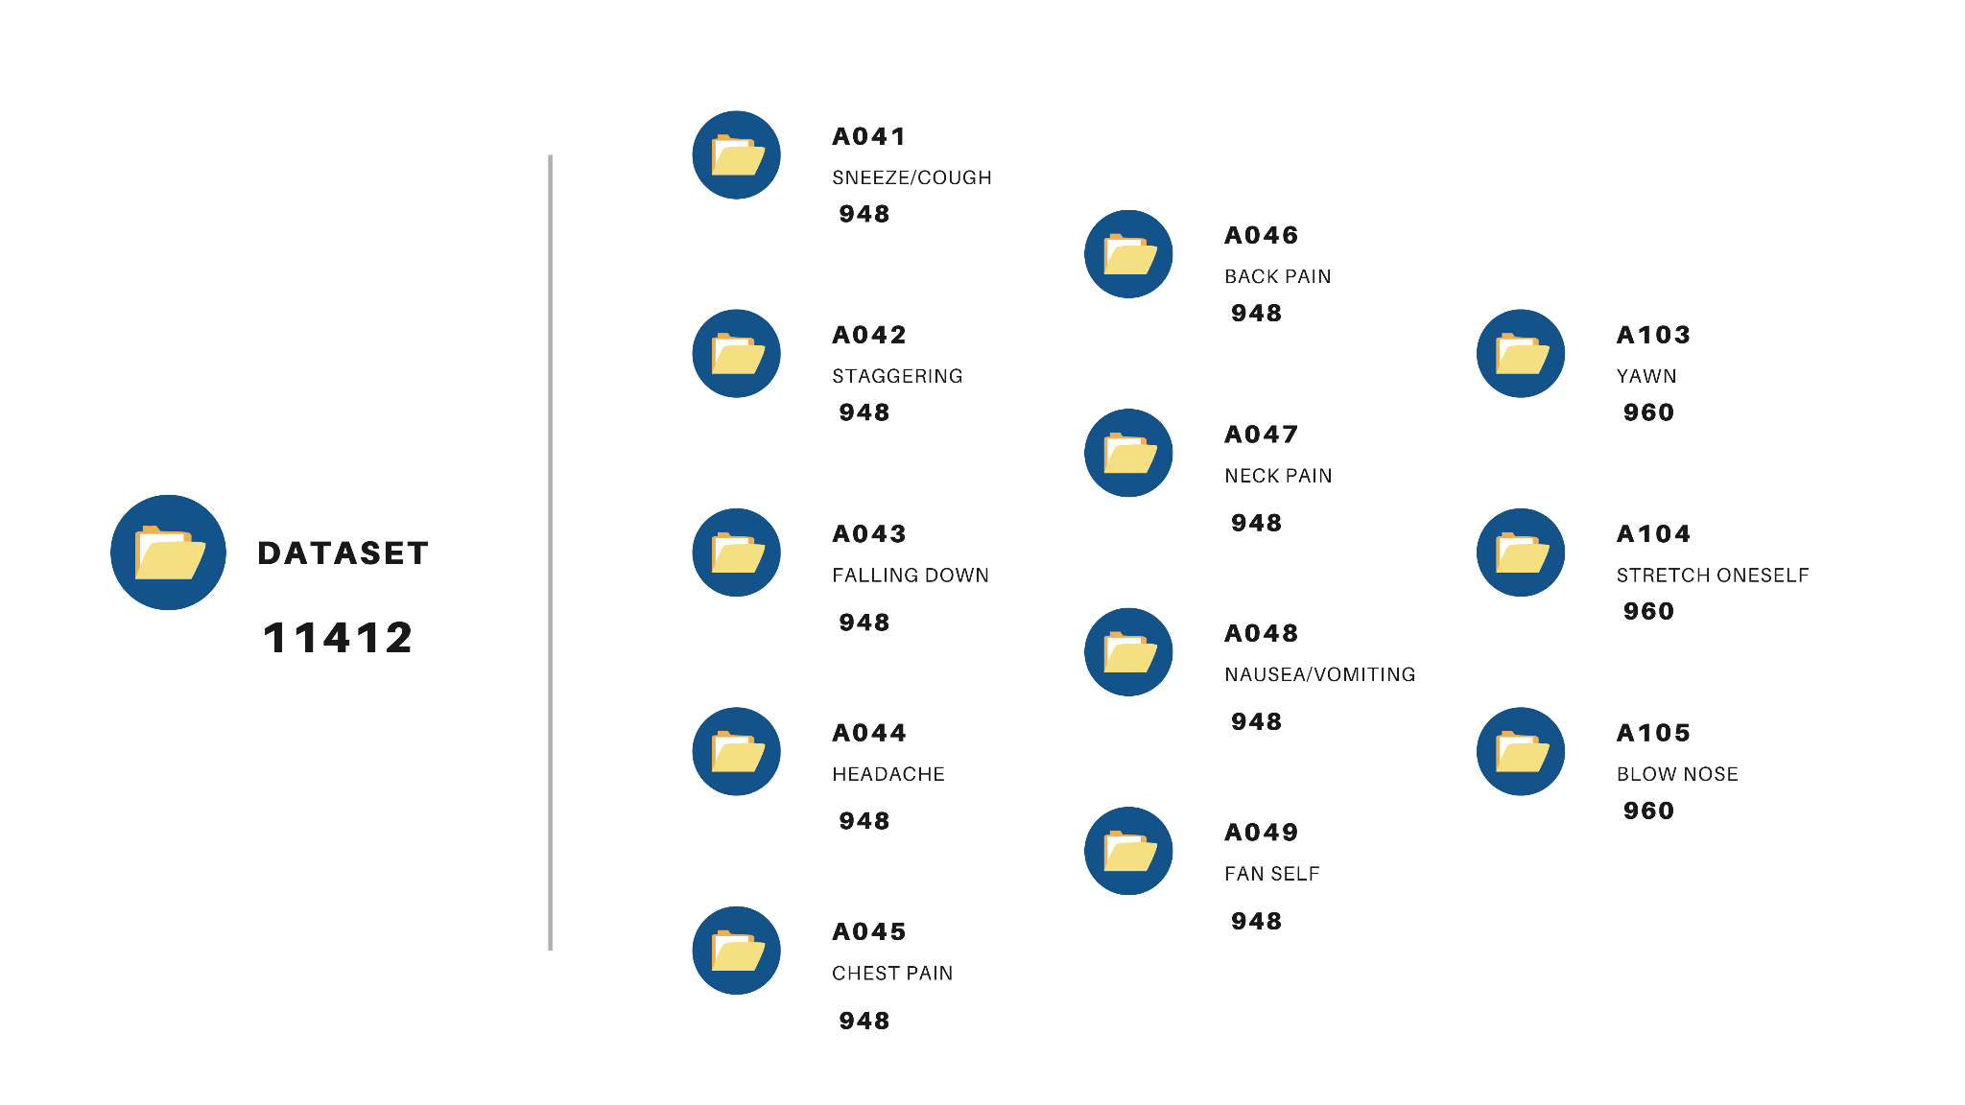
DATASET

Slide 8
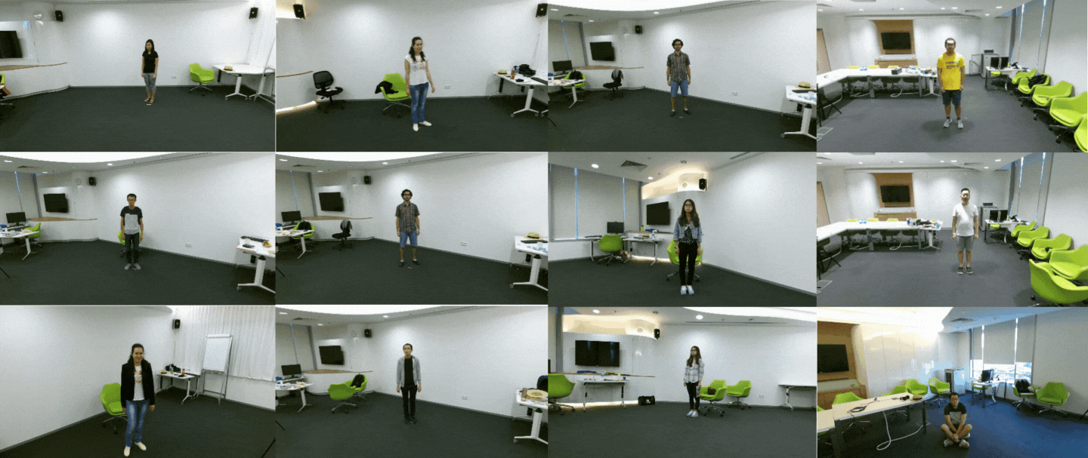
DATASET
Sample Videos from NTU-RGB-D and NTU-RGB-D 120 Dataset[5]

Slide 9
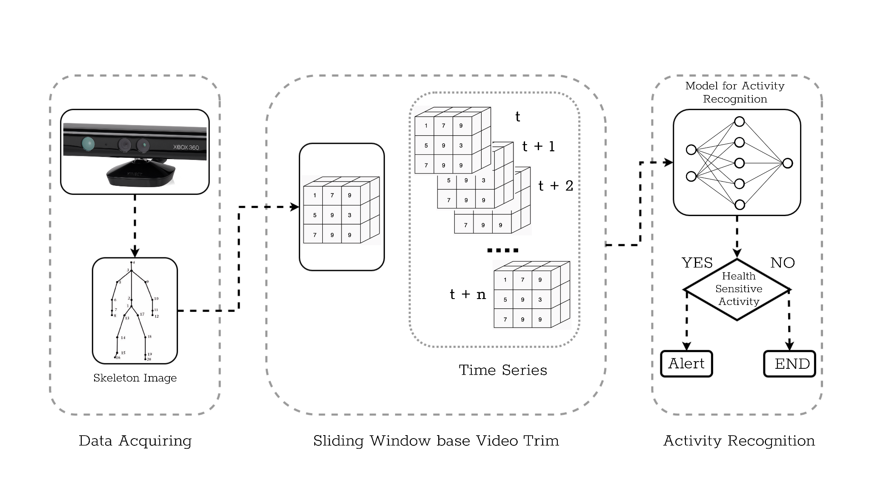
Methodology
Figure 3: Methodology

Slide 10
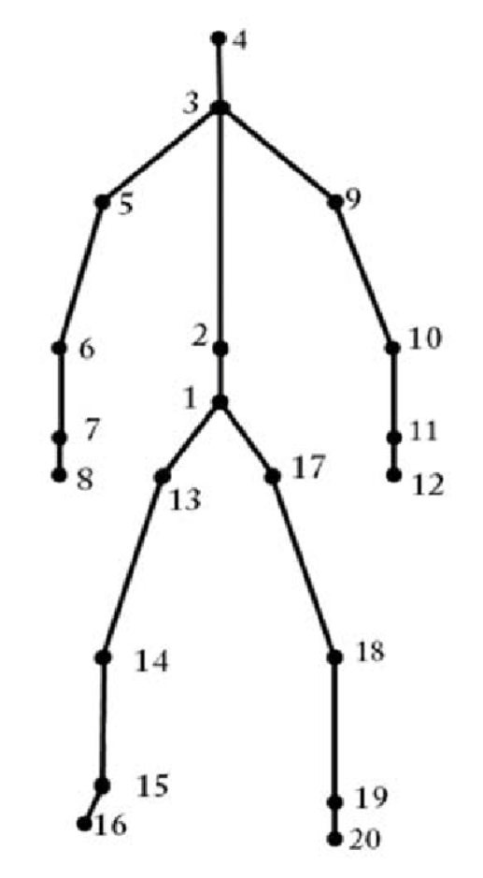
Methodology
Skeleton Image:
1.Hip center
2.Middle-spine
3.Shoulder center
4.Head
5.Left Shoulder
6.Left-elbow
7.Left-wrist
8.Left-hand
9.Right-shoulder 10.Right Elbow
11.Right-wrist
12.Right-hand 13.Left-hip 14.Left-knee
15.Left Ankle
16.Left-root 17.Right-hip 18.Right-knee 19.Right-ankle 20.Rightfoot
Figure 4: Skeleton Representation

Slide 11
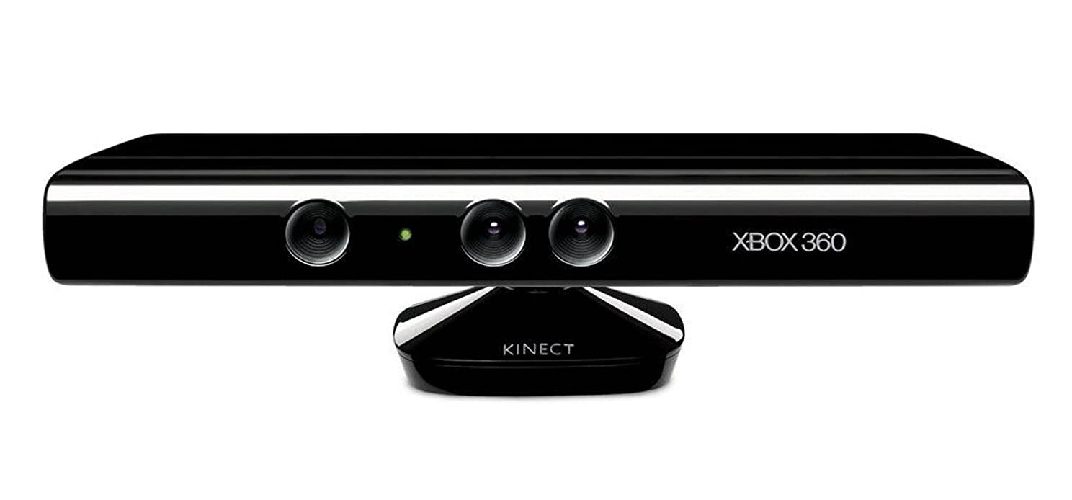
KINECT 360

Slide 12
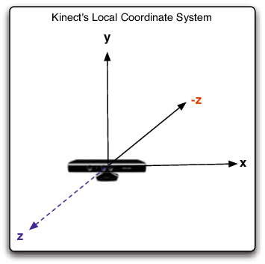
COORDINATE SYSTEM OF KINECT

Slide 13
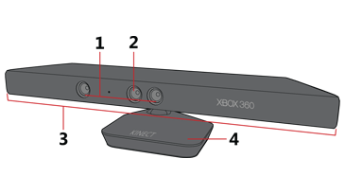
BASIC CONSTRUCTION
3D Depth sensor (IR Emitter + IR Camera / Depth Sensor)
RGB camera (Color Sensor/3D maps)
Microphone array
Tilt motor (mechanical gears for detecting floor and players in the playspace)

Slide 14
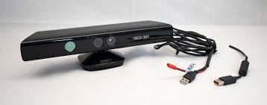
PRE REQUIREMENTS FOR CONNECTION OF PYTHON AND KINECT 360
kinect device
kinect SDK
pykinect library
python 2.7(with numpy,opencv)
any python compiler

Slide 15
Methodology
3D Matrix Representation:
P(x, y, z))
f = pn − phip
(n = 2, 3, ....N).
x = abscissa
y = ordinate
z = Distance from the human body to the camera
pn = other nodes except the hip joint
phip = the hip-center joint.

Slide 16
Methodology
Sliding Window:
Action 1
Action 2
Time Delay
Result of Action 1
Result of Action 2

Slide 17
Sliding Window:
Action 1
Action 2
Time Delay
Result of Action 1
Result of Action 2

Slide 18
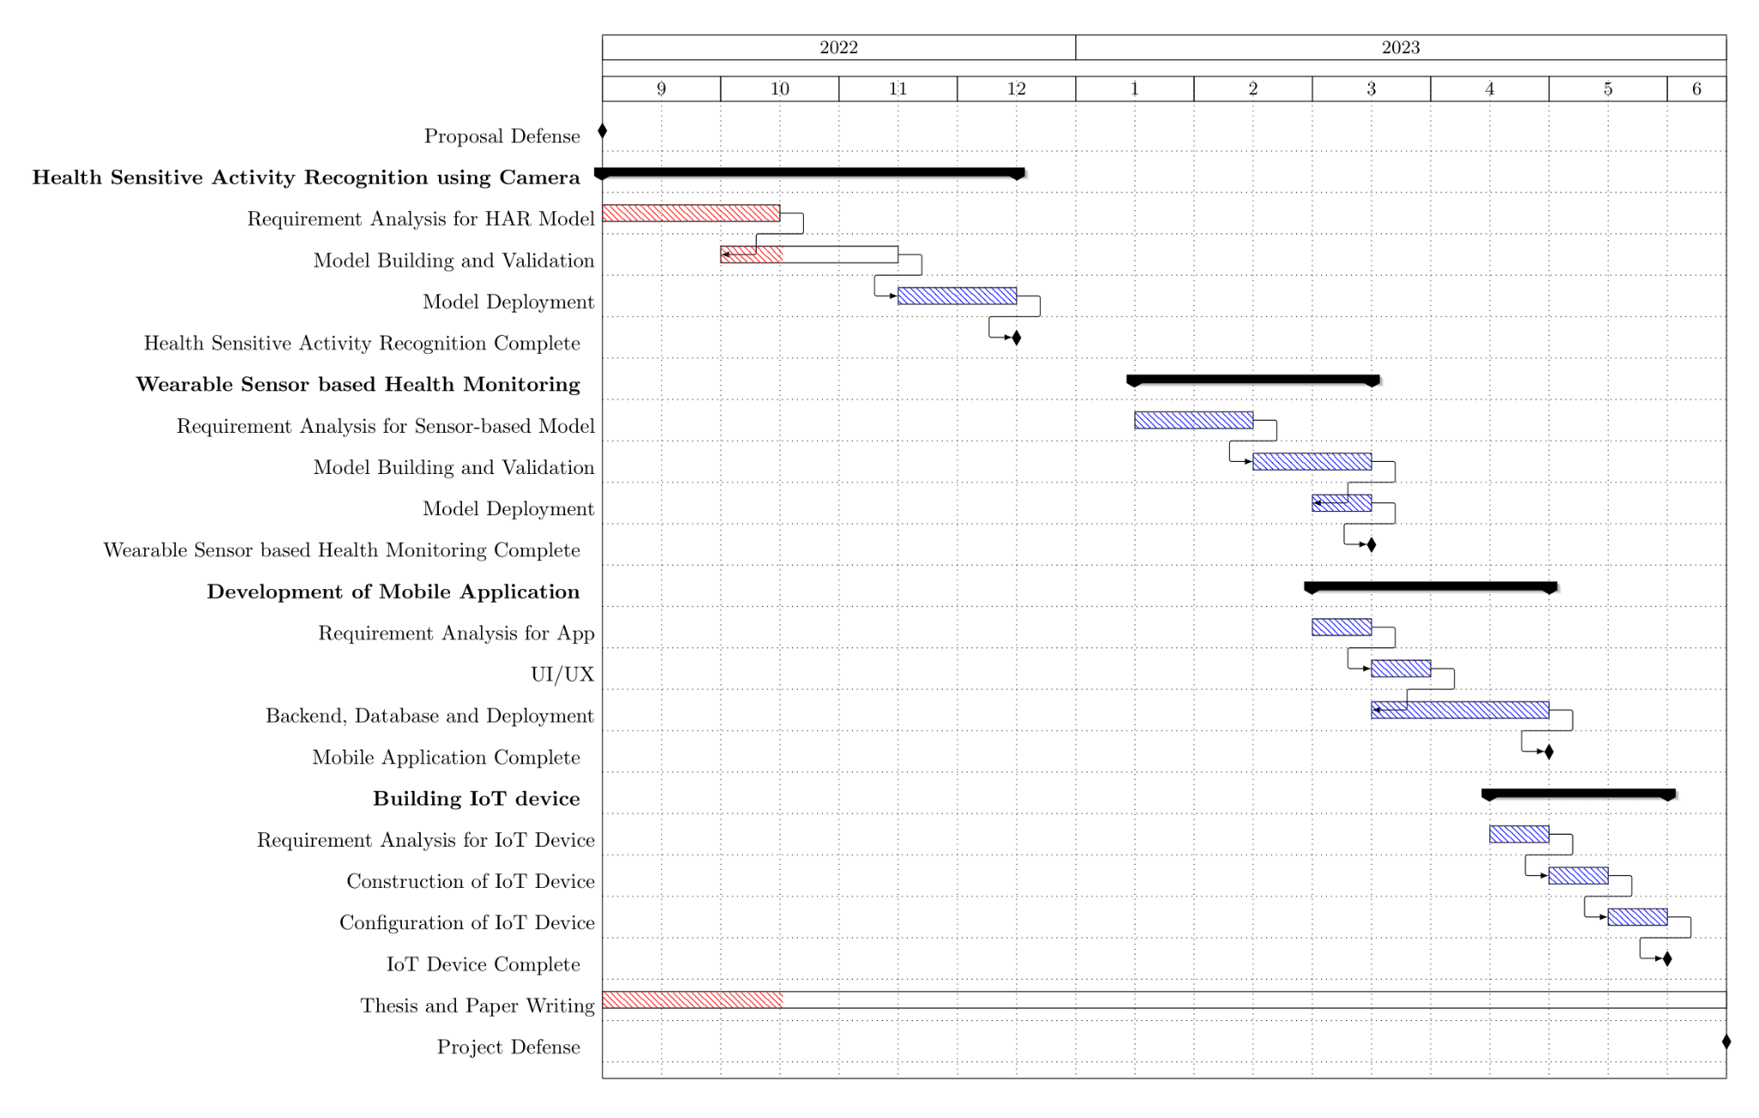
Figure 4:Gantt chart

Slide 19
demo

Slide 20
References
[1] Beddiar, D.R., Nini, B., Sabokrou, M. et al. Vision-based human activity recognition: a survey. Multimed Tools Appl 79, 30509–30555 (2020). https://doi.org/10.1007/s11042-020-09004-3
[2] Hbali, Y., Hbali, S., Ballihi, L., & Sadgal, M. (2018). Skeleton‐based human activity recognition for elderly monitoring systems. IET Computer Vision, 12(1), 16-26.
[3] Reena, J. K., & Parameswari, R. (2019, February). A smart health care monitor system in IoT based human activities of daily living: a review. In 2019 International Conference on Machine Learning, Big Data, Cloud and Parallel Computing (COMITCon) (pp. 446-448). IEEE.
[4] Kim, K., Jalal, A., & Mahmood, M. (2019). Vision-based human activity recognition system using depth silhouettes: A smart home system for monitoring the residents. Journal of Electrical Engineering & Technology, 14(6), 2567-2573.
[5] Sun, H., & Chen, Y. (2022, May). Real-Time Elderly Monitoring for Senior Safety by Lightweight Human Action Recognition. In 2022 IEEE 16th International Symposium on Medical Information and Communication Technology (ISMICT) (pp. 1-6). IEEE.

